Slide 1
Chapter 16 JavaFX UI Controls and Multimedia

Slide 2
Motivations
A graphical user interface (GUI) makes a system user-friendly and easy to use. Creating a GUI requires creativity and knowledge of how GUI components work. Since the GUI components in Java are very flexible and versatile, you can create a wide assortment of useful user interfaces.
Previous chapters briefly introduced several GUI components. This chapter introduces the frequently used GUI components in detail.

Slide 3
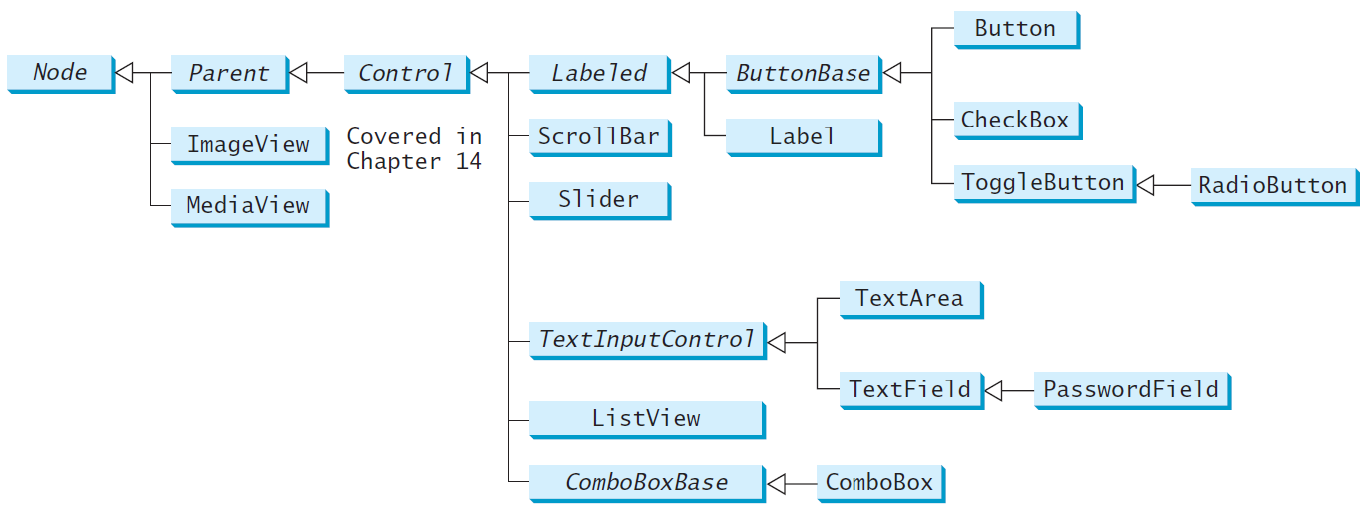
Frequently Used UI Controls
Throughout this book, the prefixes lbl, bt, chk, rb, tf, pf, ta, cbo, lv, scb, sld, and mp are used to name reference variables for Label, Button, CheckBox, RadioButton, TextField, PasswordField, TextArea, ComboBox, ListView, ScrollBar, Slider, and MediaPlayer.

Slide 4
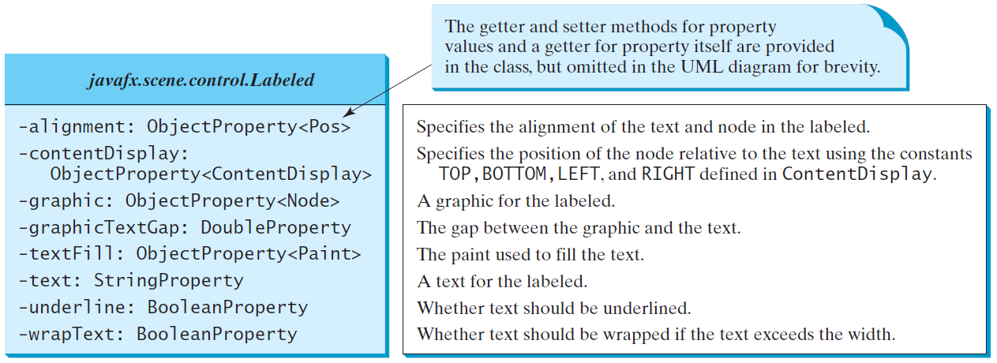
Labeled
A label is a display area for a short text, a node, or both. It is often used to label other controls (usually text fields). Labels and buttons share many common properties. These common properties are defined in the Labeled class.

Slide 5
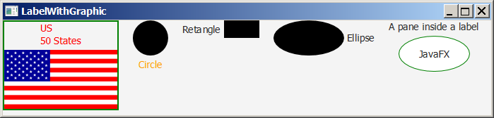
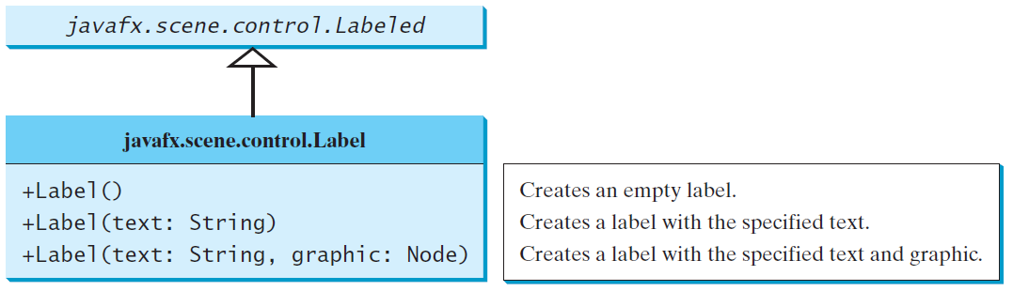
Label
The Label class defines labels.
LabelWithGraphic

Slide 6
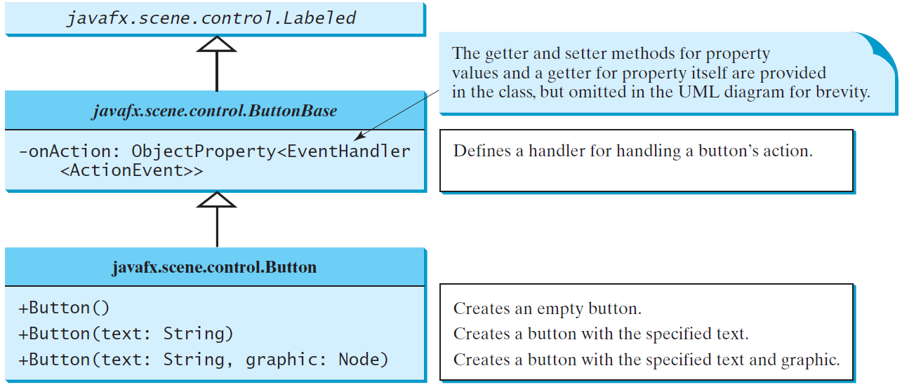
ButtonBase and Button
A button is a control that triggers an action event when clicked. JavaFX provides regular buttons, toggle buttons, check box buttons, and radio buttons. The common features of these buttons are defined in ButtonBase and Labeled classes.

Slide 7
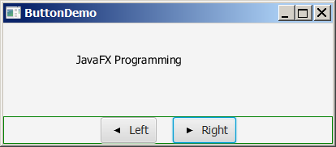
Button Example
ButtonDemo

Slide 8
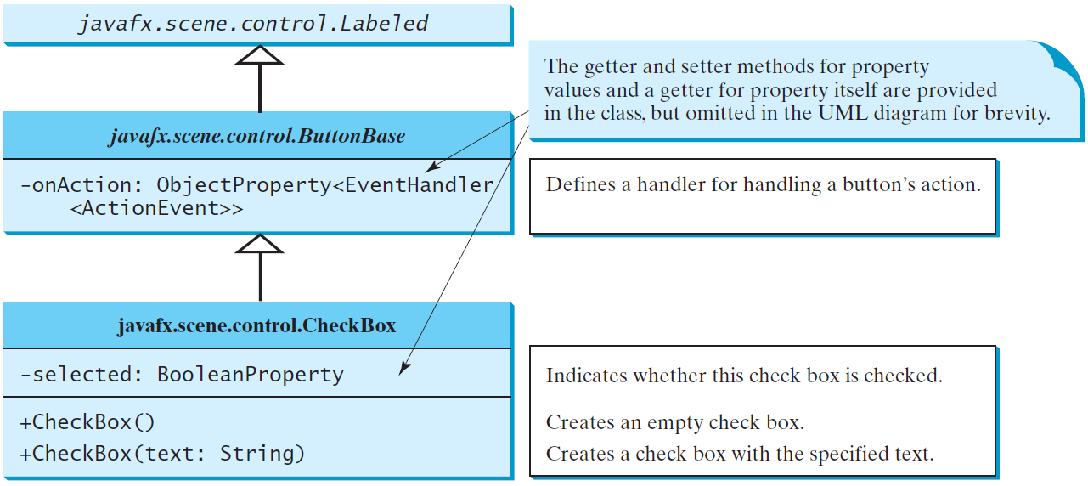
CheckBox
A CheckBox is used for the user to make a selection. Like Button, CheckBox inherits all the properties such as onAction, text, graphic, alignment, graphicTextGap, textFill, contentDisplay from ButtonBase and Labeled.

Slide 9
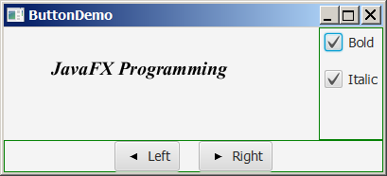
CheckBox Example
CheckBoxDemo

Slide 10
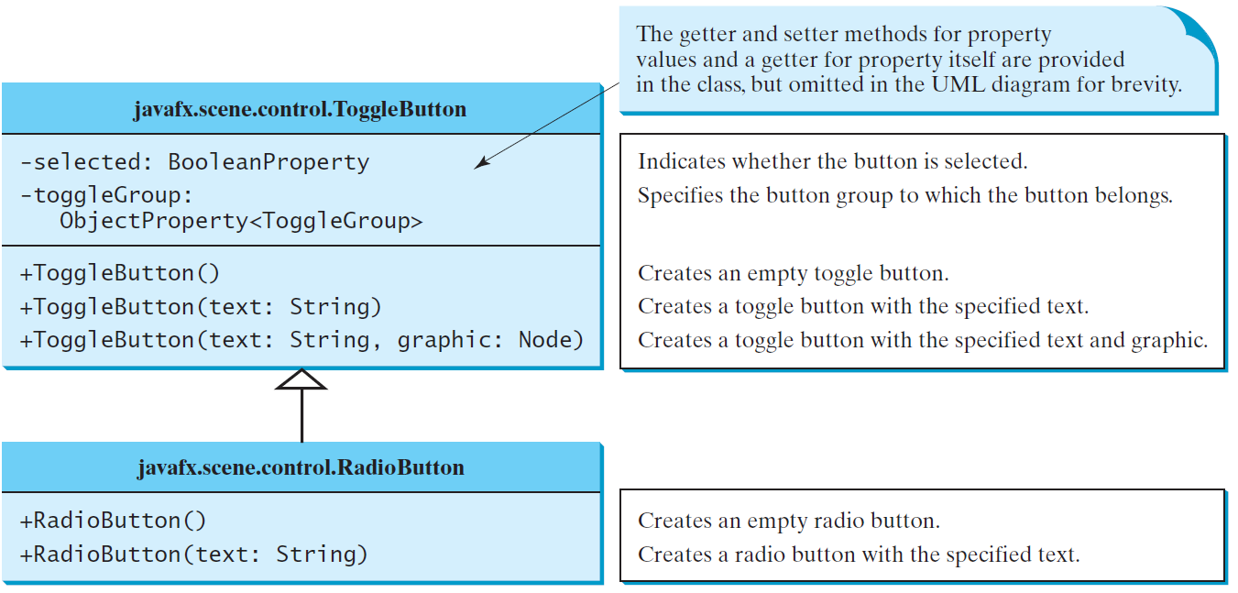
RadioButton
Radio buttons, also known as option buttons, enable you to choose a single item from a group of choices. In appearance radio buttons resemble check boxes, but check boxes display a square that is either checked or blank, whereas radio buttons display a circle that is either filled (if selected) or blank (if not selected).

Slide 11
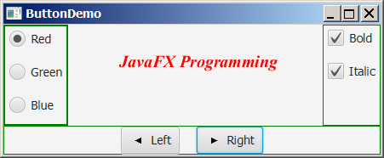
RadioButton Example
RadioButtonDemo

Slide 12
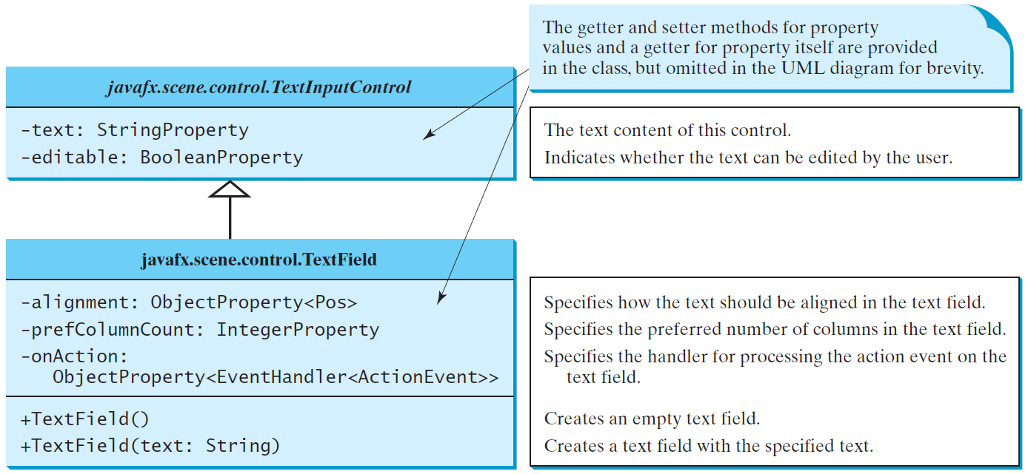
TextField
A text field can be used to enter or display a string. TextField is a subclass of TextInputControl.

Slide 13
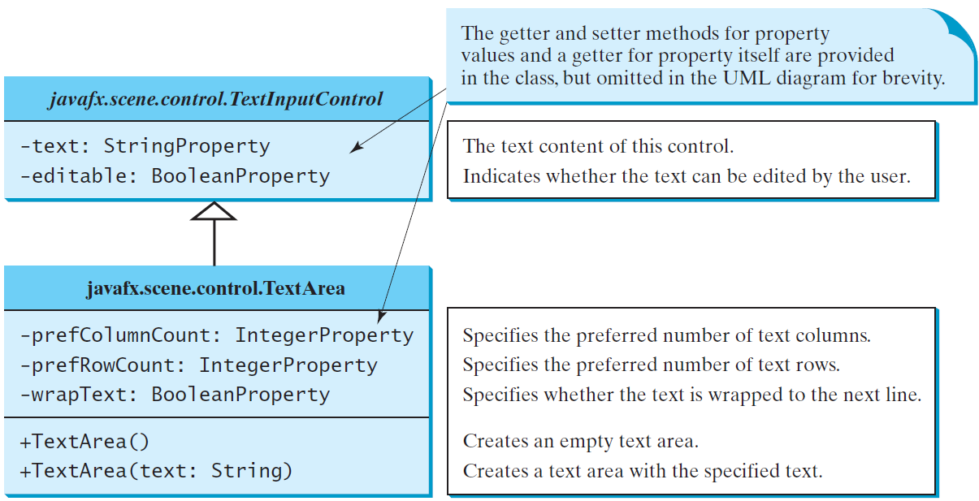
TextArea
A TextArea enables the user to enter multiple lines of text.

Slide 14
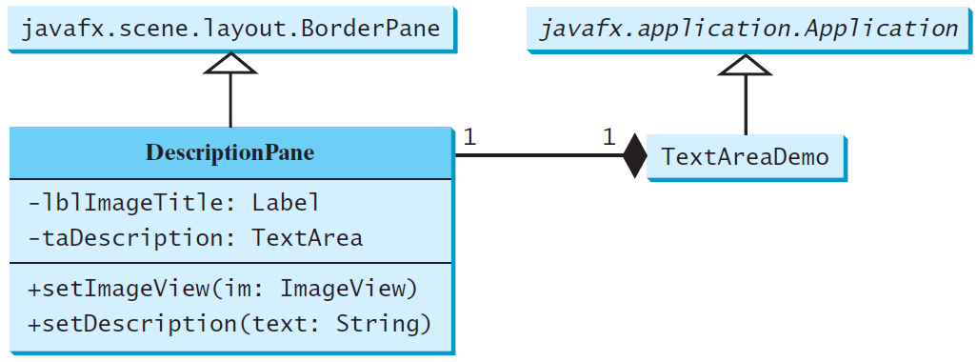
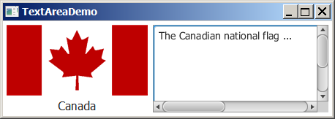
TextArea Example
DescriptionPane
TextAreaDemo

Slide 15
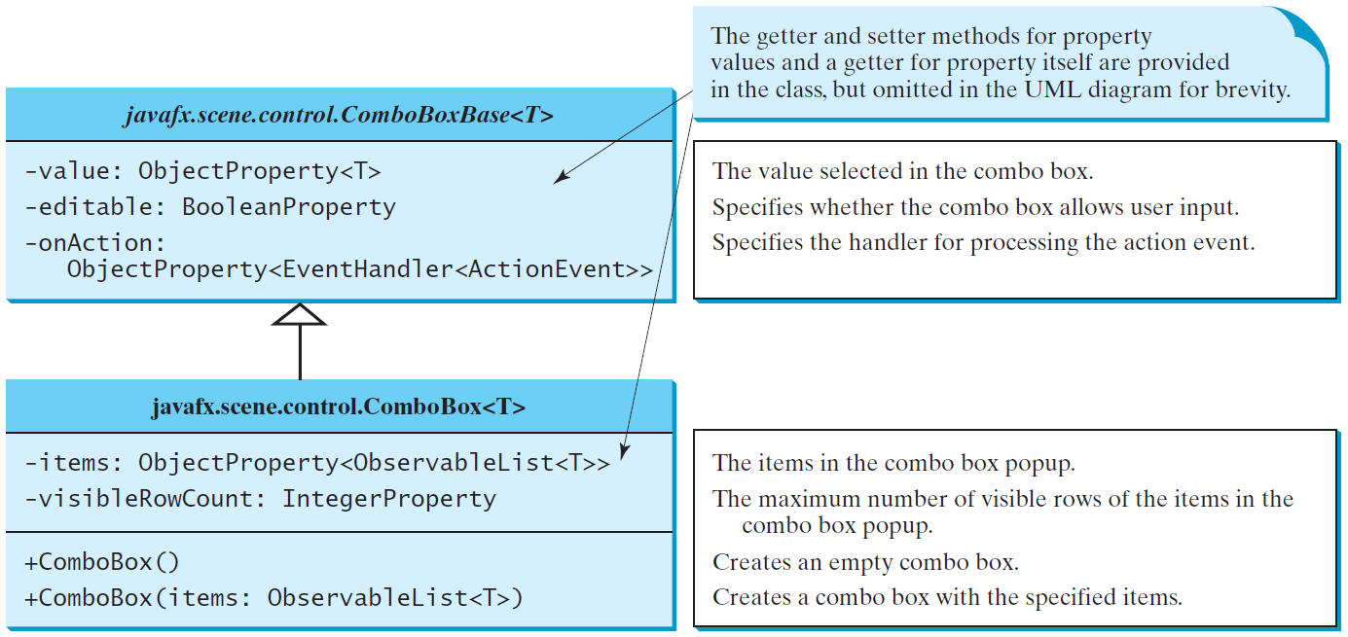
ComboBox
A combo box, also known as a choice list or drop-down list, contains a list of items from which the user can choose.

Slide 16
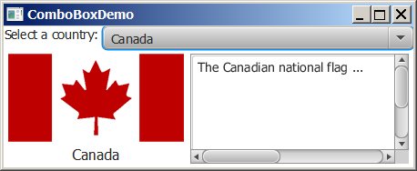
ComboBox Example
This example lets users view an image and a description of a country's flag by selecting the country from a combo box.
ComboBoxDemo

Slide 17
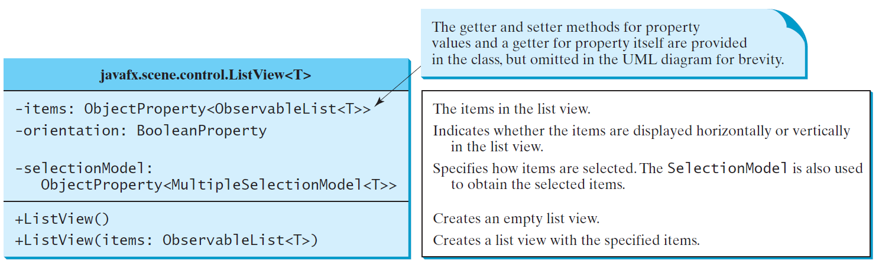
ListView
A list view is a component that performs basically the same function as a combo box, but it enables the user to choose a single value or multiple values.

Slide 18
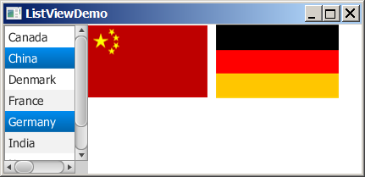
Example: Using ListView
This example gives a program that lets users select countries in a list and display the flags of the selected countries in the labels.
ListViewDemo

Slide 19
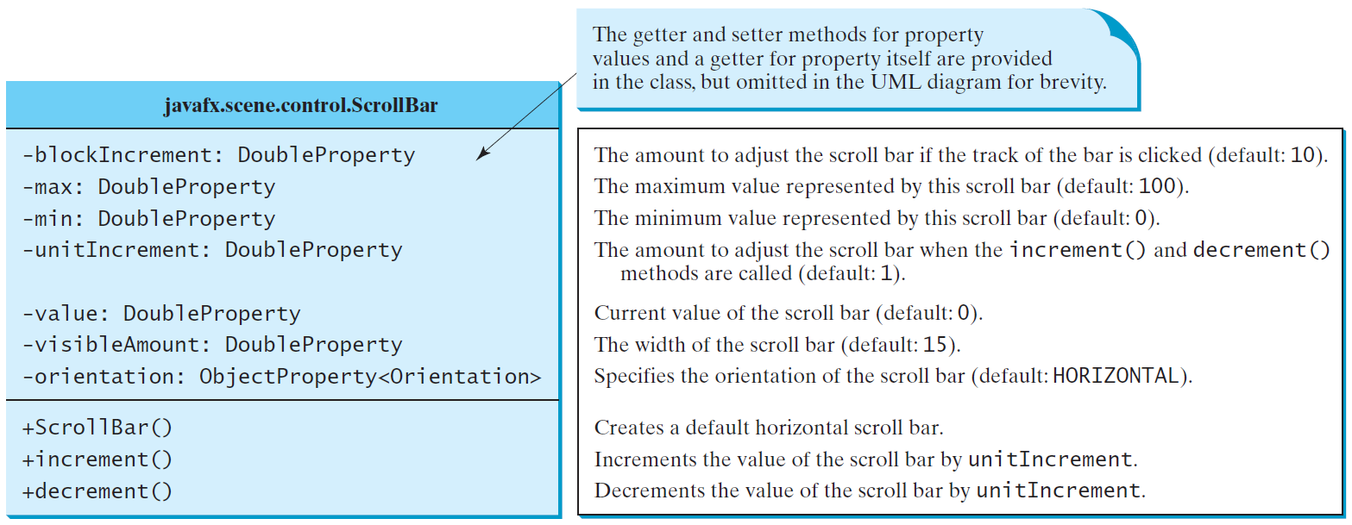
ScrollBar
A scroll bar is a control that enables the user to select from a range of values. The scrollbar appears in two styles: horizontal and vertical.

Slide 20
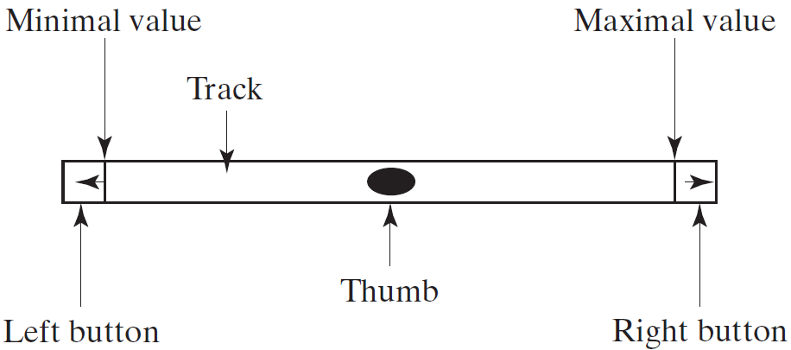
Scroll Bar Properties

Slide 21
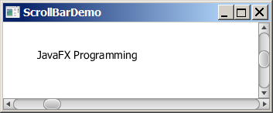
Example: Using Scrollbars
This example uses horizontal and vertical scrollbars to control a message displayed on a panel. The horizontal scrollbar is used to move the message to the left or the right, and the vertical scrollbar to move it up and down.
ScrollBarDemo

Slide 22
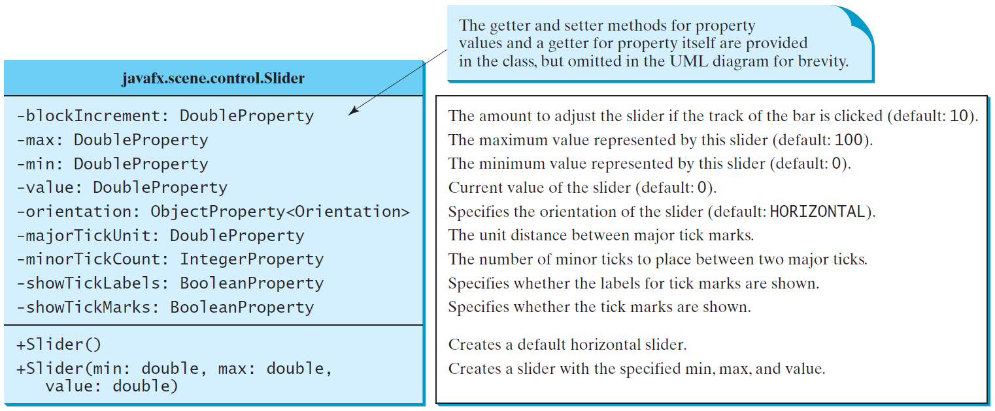
Slider
Slider is similar to ScrollBar, but Slider has more properties and can appear in many forms.

Slide 23
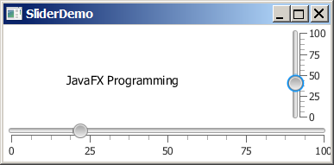
Example: Using Sliders
Rewrite the preceding program using the sliders to control a message displayed on a panel instead of using scroll bars.
SliderDemo

Slide 24
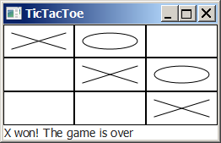
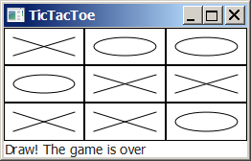
Case Study: TicTacToe

Slide 25
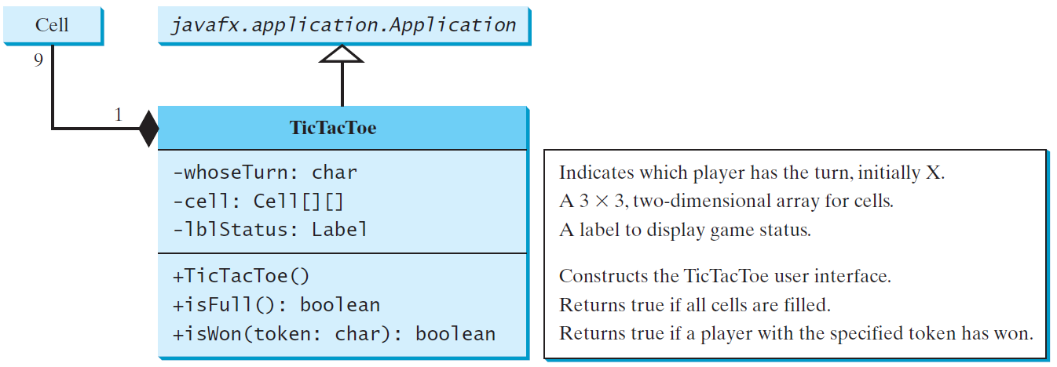
Case Study: TicTacToe, cont.
TicTacToe

Slide 26
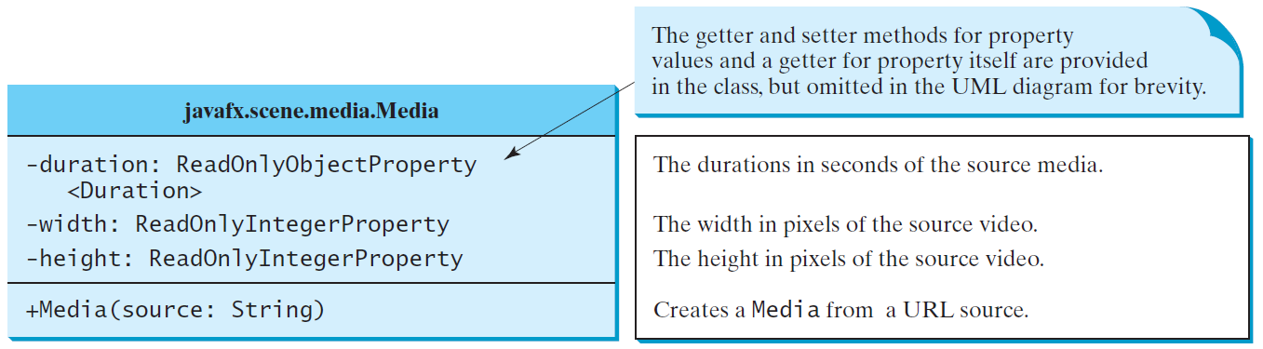
Media
You can use the Media class to obtain the source of the media, the MediaPlayer class to play and control the media, and the MediaView class to display the video.

Slide 27
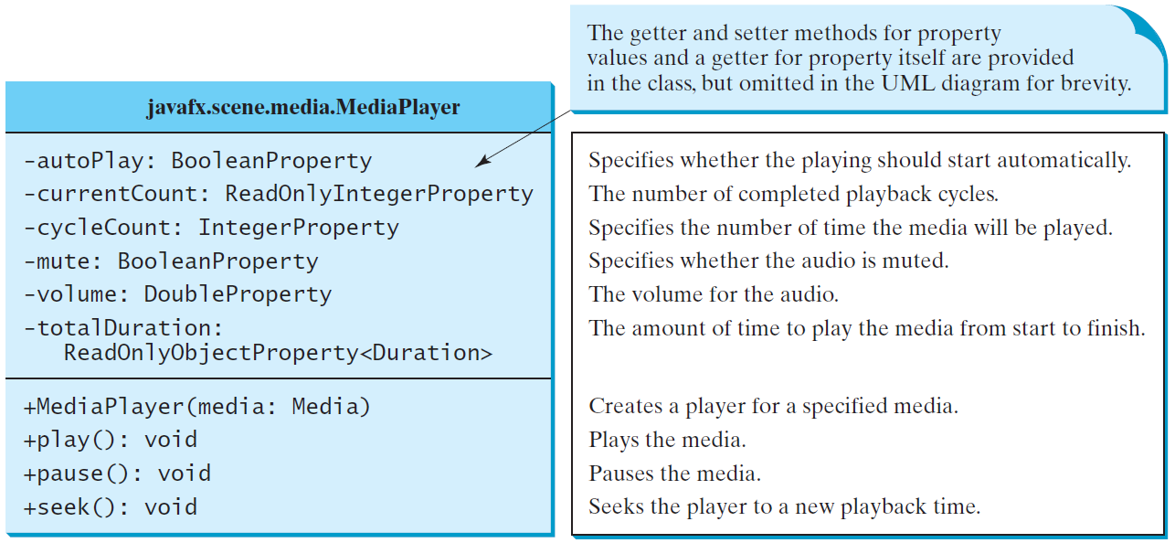
MediaPlayer
The MediaPlayer class playes and controls the media with properties such as autoPlay, currentCount, cycleCount, mute, volume, and totalDuration.

Slide 28
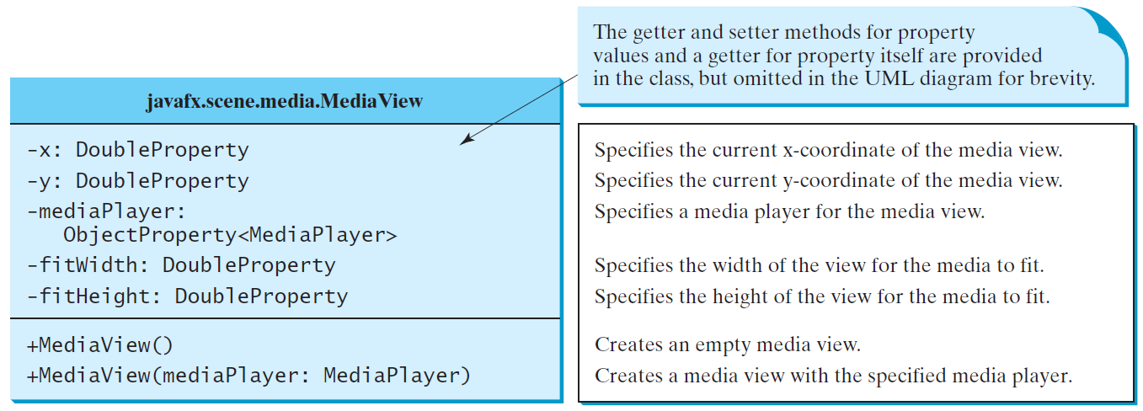
MediaView
The MediaView class is a subclass of Node that provides a view of the Media being played by a MediaPlayer. The MediaView class provides the properties for viewing the media.

Slide 29
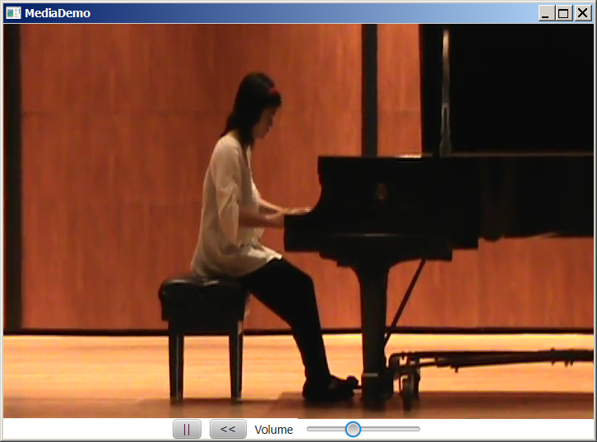
Example: Using Media
This example displays a video in a view. You can use the play/pause button to play or pause the video and use the rewind button to restart the video, and use the slider to control the volume of the audio.
MediaDemo

